Slide 1
Conway’s Game Of Life
Java Programming (19ECSP301)
Submitted by:
Sanjay Keshwar 01fe18bcs192
Sumer Singh 01fe18bcs229

Slide 2
Problem Statement:
The Game of Life (an example of a cellular automaton) is played on an infinite two-dimensional rectangular grid of cells. Each cell can be either alive or dead. The status of each cell changes each turn of the game (also called a generation) depending on the statuses of that cell's 8 neighbors. Neighbors of a cell are cells that touch that cell, either horizontal, vertical, or diagonal from that cell.
Conway's Game Of Life is a Cellular Automation Method created by John Horton Conway. This game was created with Biology in mind but has been applied in various fields such as Graphics, terrain generation, etc.

Slide 3
Objectives:
The initial pattern is the first generation. The second generation evolves from applying the rules simultaneously to every cell on the game board, i.e. births and deaths happen simultaneously. Afterwards, the rules are iteratively applied to create future generations. For each generation of the game, a cell's status in the next generation is determined by a set of rules.
These simple rules are as follows:
Any live cell with fewer than two live neighbors dies, as if caused by under population.
Any live cell with two or three live neighbors lives on to the next generation.
Any live cell with more than three live neighbors dies, as if by overpopulation.
Any dead cell with exactly three live neighbors becomes a live cell, as if by reproduction.
There are, of course, as many variations to these rules as there are different combinations of numbers to use for determining when cells live or die.

Slide 4
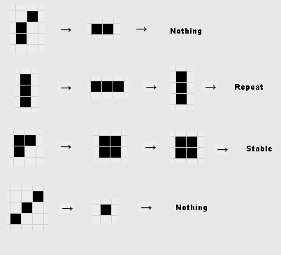
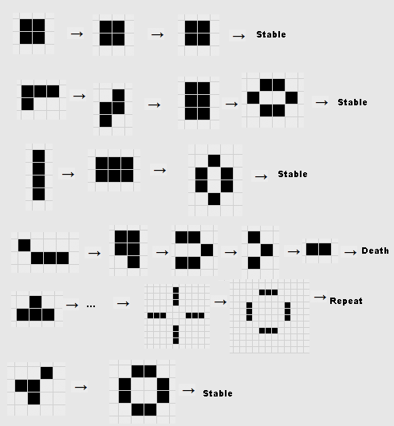
Some example Patterns :
One can investigate the evolution of the simplest patterns if done carefully. They should verify that any single living cell or any pair of living cells will die during the next iteration.

Slide 5
List of Classes:
Main
It includes the main method from where the frame’s visibility is set to true and frame is visible as output.
2. GameOfLifeSetup
It contains the logic of Game of Life and operations needed to be done to generate new generations.
3. GameOfLife
It extends the JFrame and design properties such as labels, button, sliders and different types of layout to create GUI.
4. MatrixPanel
It is the design of the right side of frame, where you can visualise the 2D animation of Game of Life.

Slide 6
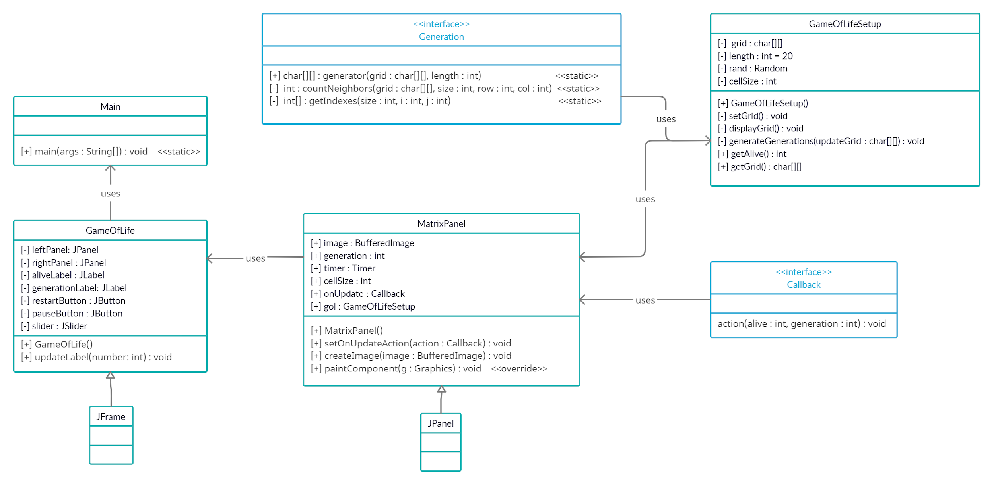
Class Diagram:

Slide 7
List of Data Structures Used:
A matrix is a two-dimensional data structure and all of its elements are of the same type.
Matrix data structure is used for grid representation.

Slide 8
Algorithm
1. Randomly initialize all the cells in the grid
2. At each time step in the simulation, for each cell (i, j) in the grid, do the following:
• Update the value of cell (i, j) based on its neighbors, taking into account the boundary conditions.
• Update the display of grid values.
3. Using the updated grid, change the GUI in Frame
4. If pauseButton is Pressed:
• Stop the timer and current generation will be stopped. If pressed again resume the timer.
5. If restartButton is Pressed:
• Start from Step 1

Slide 9
User Interface:

Slide 10
Thank You

